Slide 1

Thera Bank – Project 6
Sarah A. Thomas

Slide 2
Business Problem Overview and Solution Approach
Recently, here at Thera Bank, there has been a major decline in the number of credit card users. This has made a major impact to revenue given the money earned from annual fees, balance transfer fees, cash advance fees, late payment fees, and foreign transaction fees.
The members of the Data Science team have come up with a model to assist the bank in determining which customers are more likely to attrite. This model will help the bank re-evaluate its service offerings.
This model is a classification model using Python. The Data Science team has used methods such as Decision Tree, AdaBoost, GradientBoost, along with oversampling and undersampling methods. In the end, we will present an AdaBoost model used with the undersampling strategy as the final, best performing model.

Slide 3
Data Overview (1 of 2)
Variable | Description
CLIENTNUM | Unique identifier – Client Number
Attrition_Flag (Target Variable) | “Attrited Customer” if account is closed, otherwise “Existing Customer”
Customer_Age | Customer age in years
Gender | Gender of the customer
Dependent_count | Number of customer’s dependents
Education_Level | Possible values: Graduate, High School, Unknown, Uneducated, College, Post-Graduate, Doctorate
Marital_Status | Customer’s marital status
Income_Category | Annual income range of the account holder
Card_Category | Type of card (e.g., Platinum, Silver, etc.)
Months_on_book | Period of relationship with the bank

Slide 4
Data Overview (2 of 2)
Variable | Description
Total_Relationship_Count | Number of products held by the customer
Months_Inactive_12_mon | No. of months inactive in the last 12 months
Contacts_Count_12_mon | No. of contacts between customer and bank in past 12 months
Credit_Limit | Credit limit on the credit card
Total_Revolving_Bal | The balance that carries over from one month to the next
Avg_Open_To_Buy | Amount left on the credit card to use
Total_Trans_Amt | Total transaction amount (last 12 months)
Total_Trans_Ct | Total transaction count (last 12 months)
Total_Ct_Chng_Q4_Q1 | Ratio of the total transaction count in 4th quarter and in 1st quarter
Total_Amt_Chng_Q4_Q1 | Ratio of the total transaction amount in 4th quarter and in 1st quarter
Avg_Utilization_Ratio | How much of the available credit the customer spent

Slide 5
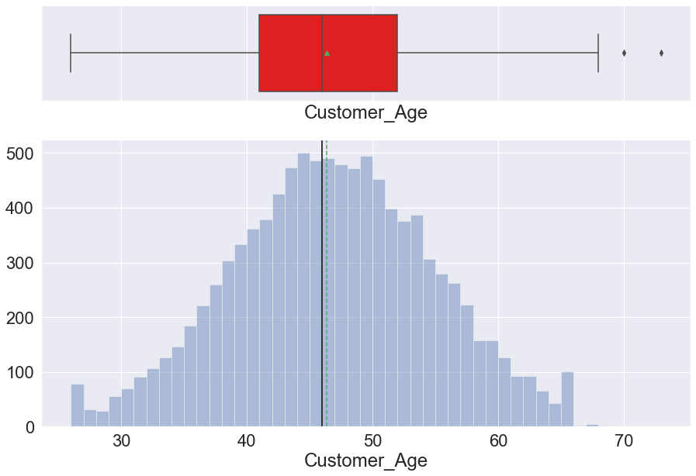
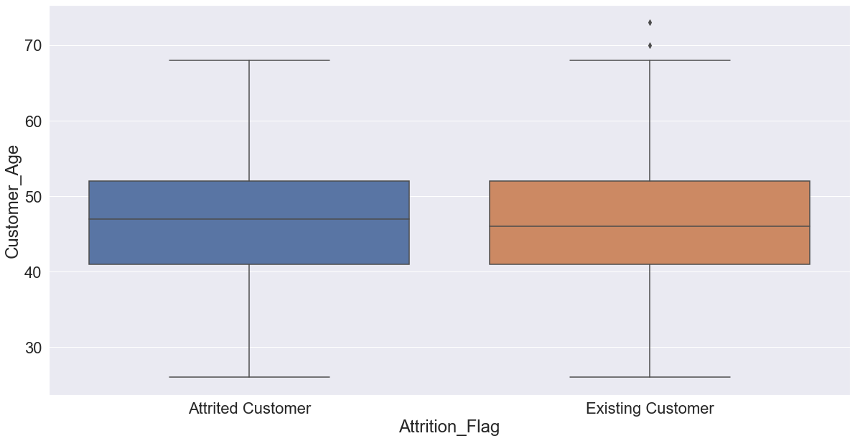
Customer_age
There are outliers so distribution is slightly right-skewed (not treated since so close to the rest of values). There seems to be no
age difference in attrited customers vs. existing customers.

Slide 6
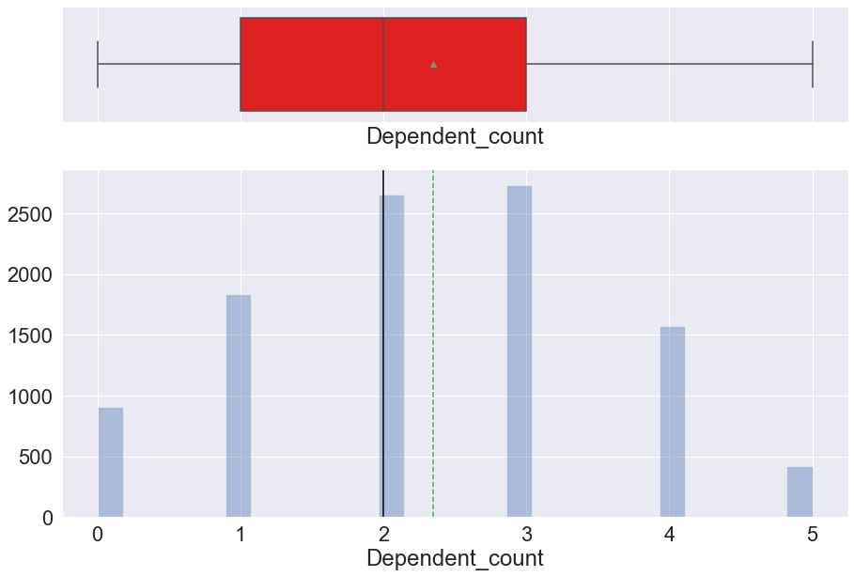
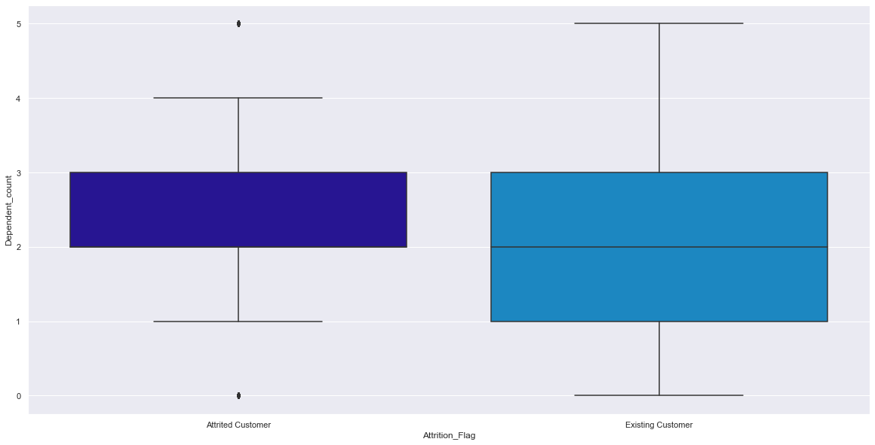
Dependent_Count
Distribution is symmetrical. There is a wider range of dependent count with existing customers.

Slide 7
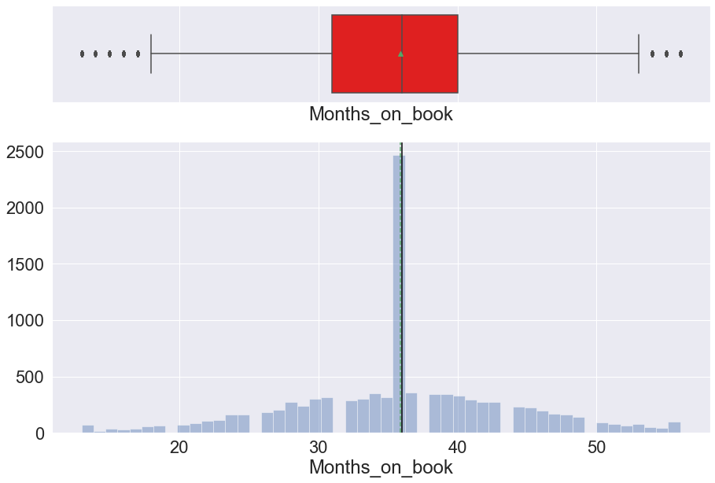
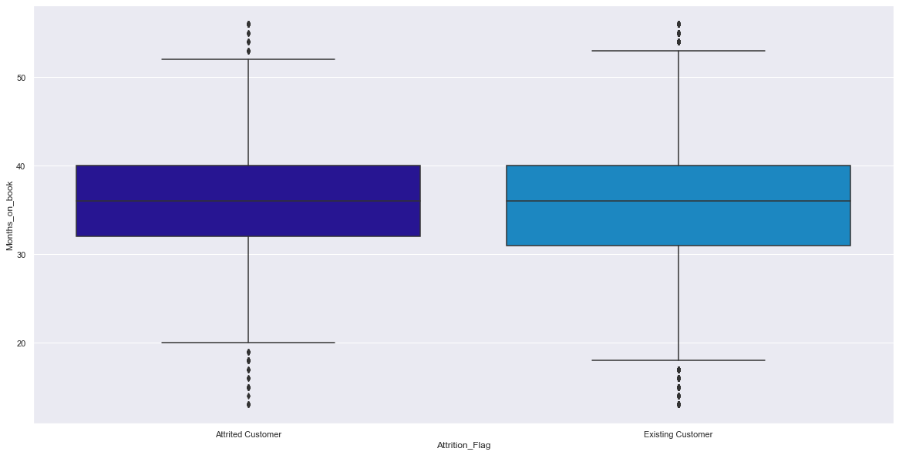
Months_on_Book
There are outliers on either side. Since these values lie close to the other values and some variation is expected, these will not be treated. Existing customers tend to have been with the bank for a slightly wider range of time.

Slide 8
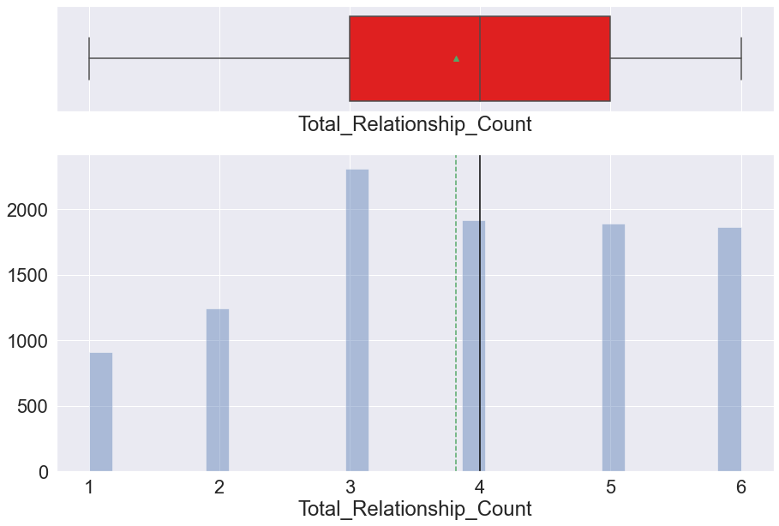
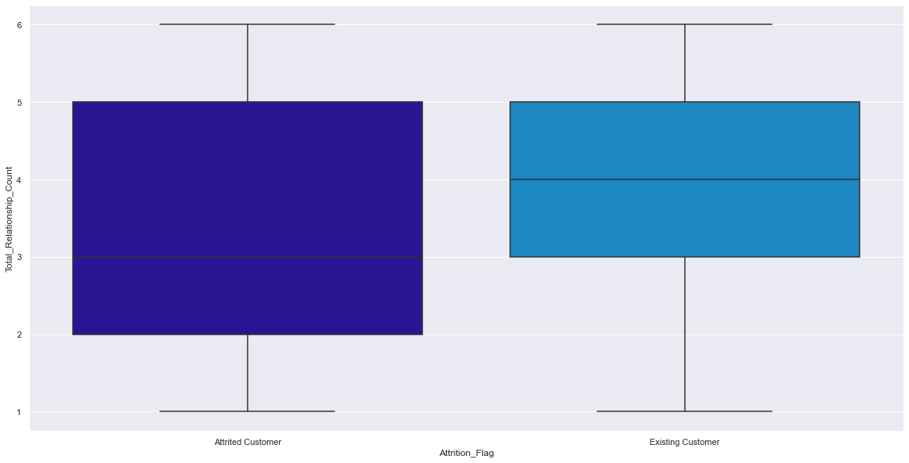
Total_Relationship_Count
Customers on average have approx. 4 products with bank (median - 4, min - 1, max - 6). Attrited customers include those who had less number of products with the bank.

Slide 9
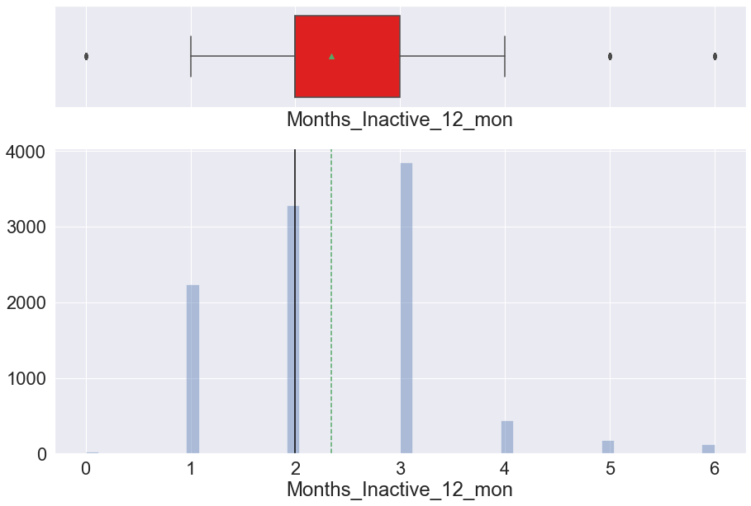
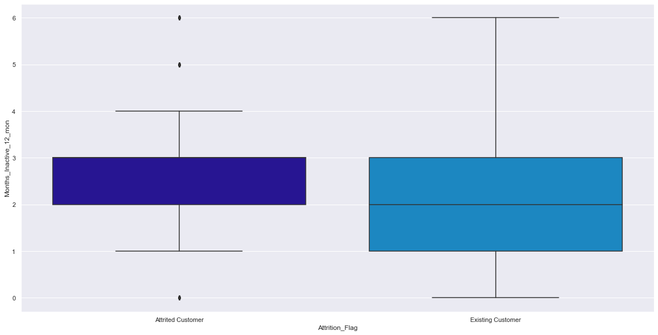
Months_Inactive_12_mon
There are outliers on either side. Since these values are still close to the other values they will not be treated as outliers. Existing customers include those who have been inactive less during the last 12-month period.

Slide 10
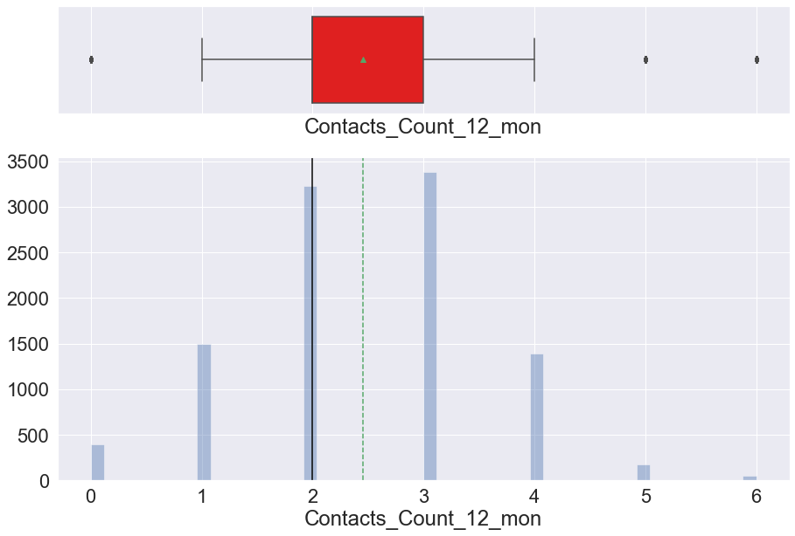
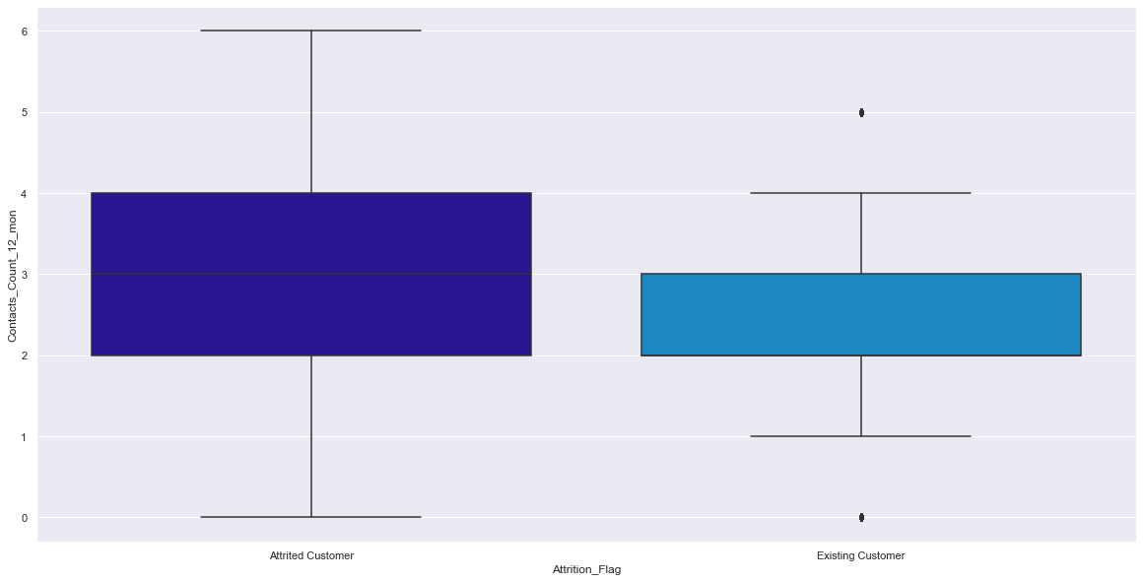
Contacts_Count_12_mon
There are outliers on either side. Since these values are still close to the other values they will not be treated as outliers. Attrited customers tend to have had more contacts with the bank in the past 12 months.

Slide 11
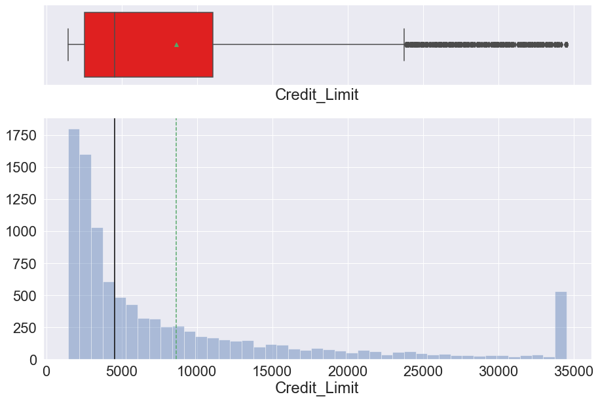
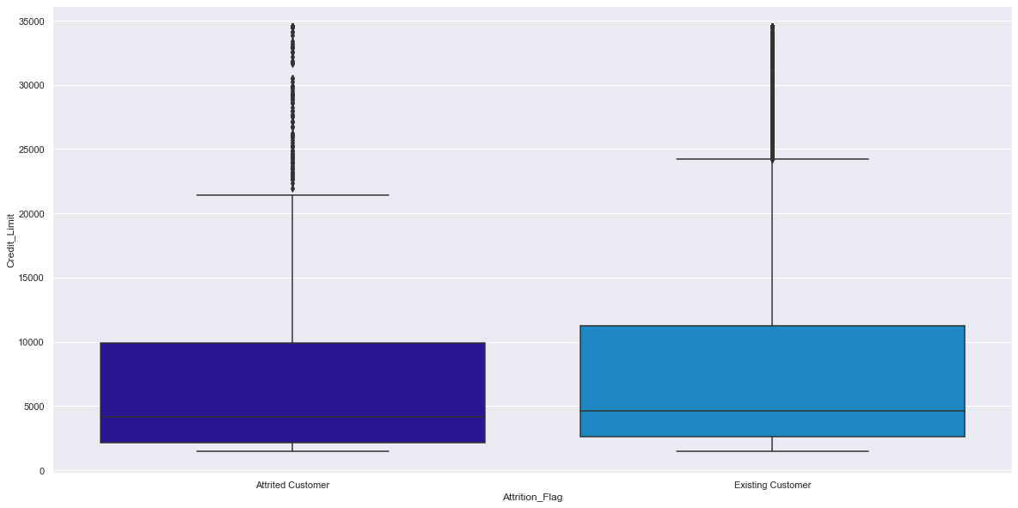
Credit_Limit
Distribution is right-skewed with outliers on the right. However, these will not be treated since some variation is expected in variables like Credit Limit. Attrited customers have a slightly smaller credit limit than existing customers.

Slide 12
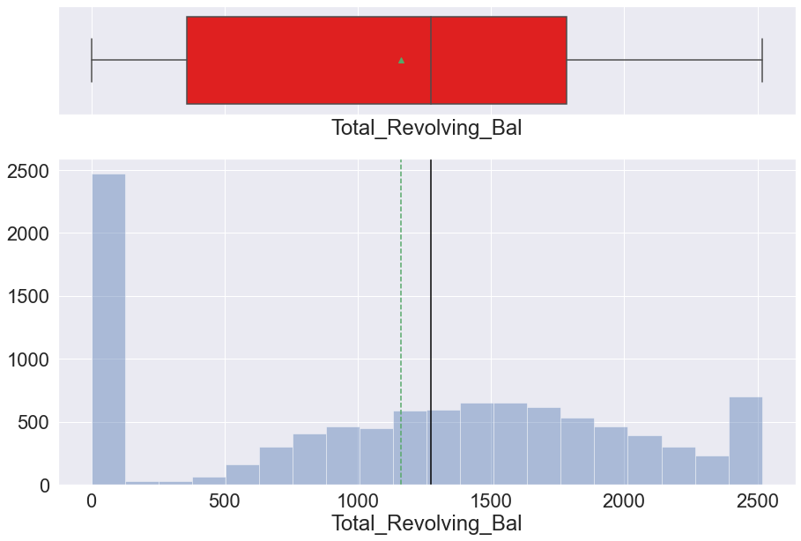
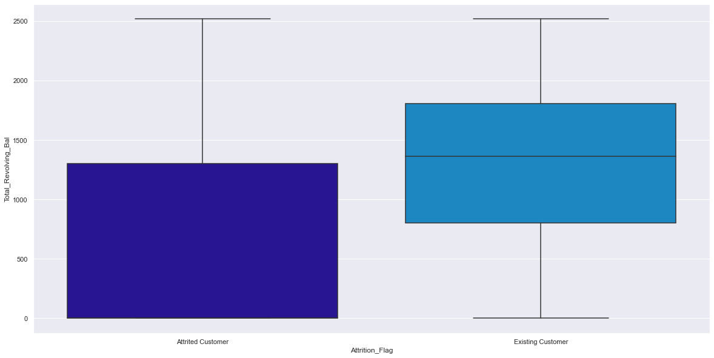
Total_Revolving_bal
Many customers (nearly 2500) have a total revolving balance of $0. Existing customers have a higher revolving balance than attrited customers.

Slide 13
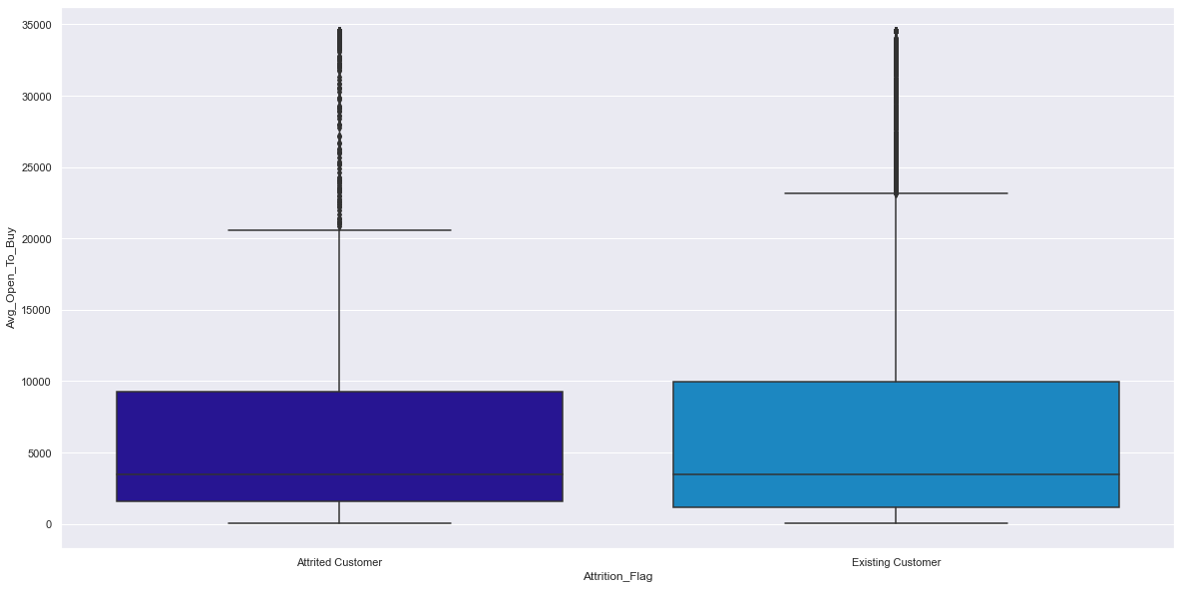
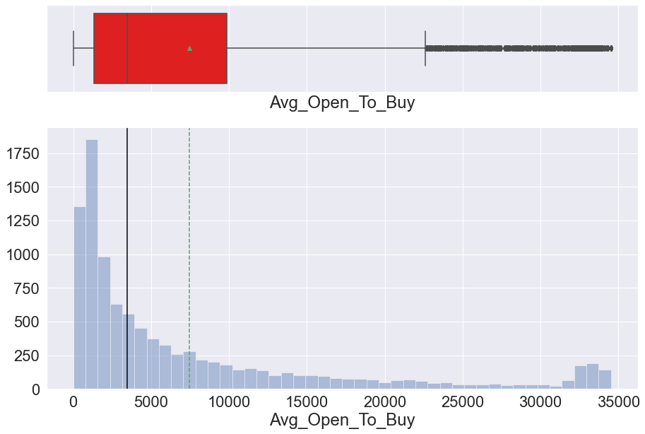
Avg_Open_To_BUY
Distribution is right-skewed with outliers to the right. However, these will not be treated since some variation is expected in variables like Average Open to Buy. Average Open to Buy is comparable between attrited and existing customers.

Slide 14
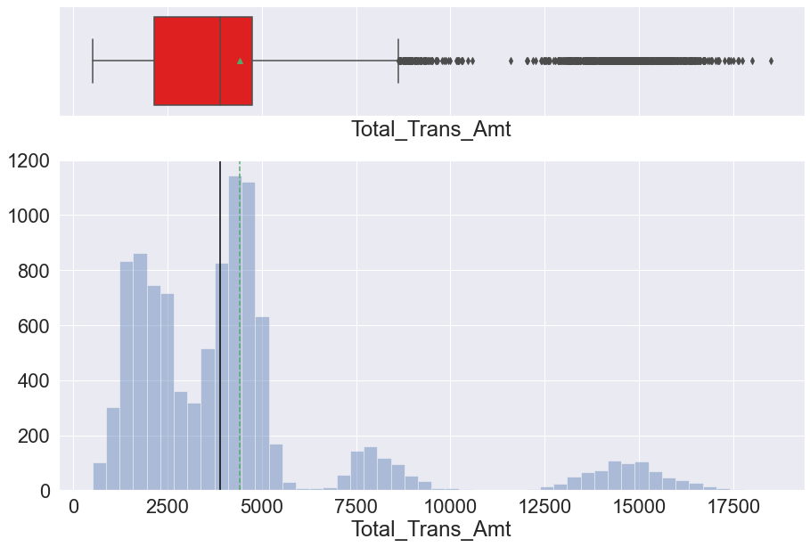
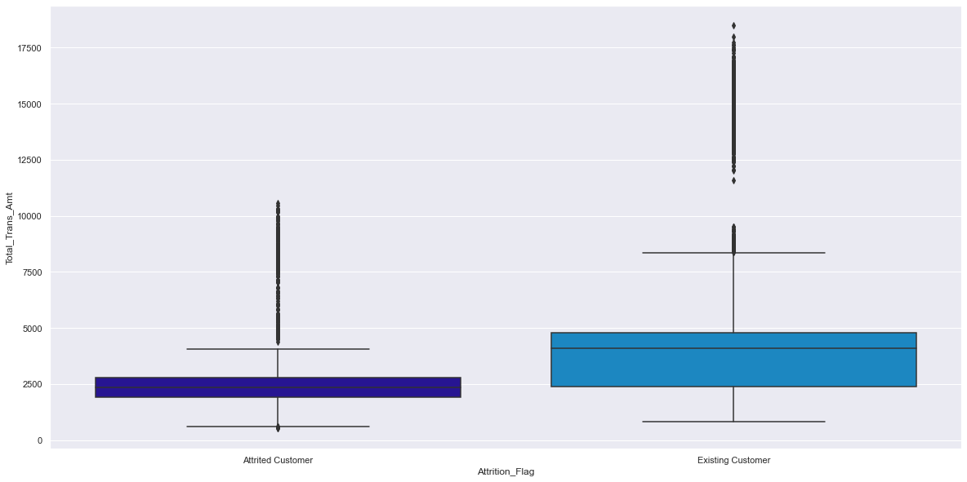
Total_Trans_Amt
Distribution is right-skewed with outliers to the right. However, these will not be treated since some variation is expected in variables like Total Transaction Amount. Total Transaction Amount tends to be higher with existing customers.

Slide 15
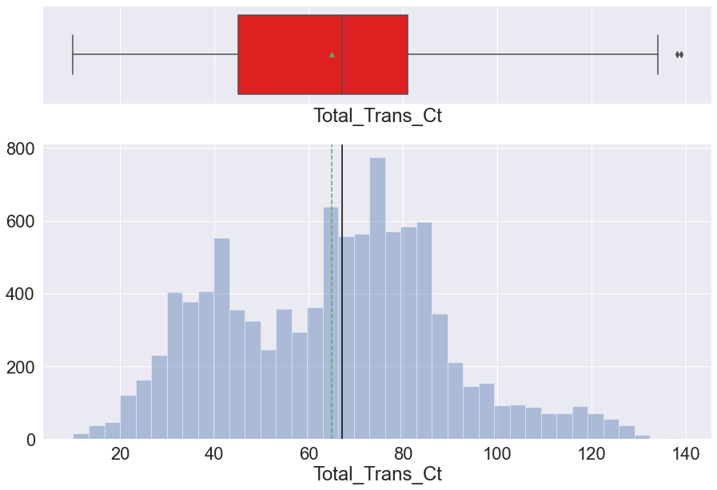
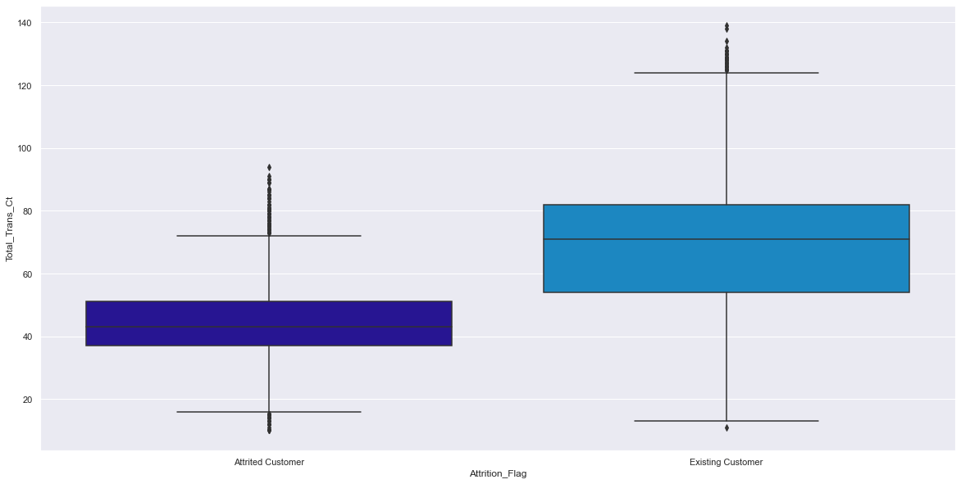
Total_Trans_Ct
Distribution is slightly right-skewed with outliers to the right. After further investigation of data, determined that outliers were still close to other data so did not treat as outliers. Total Transaction Count tends to be higher with existing customers.

Slide 16
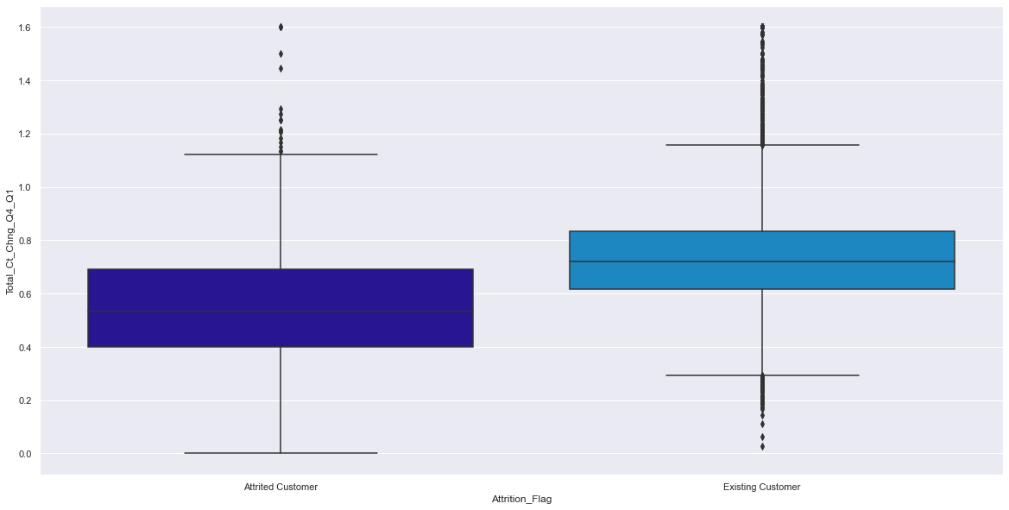
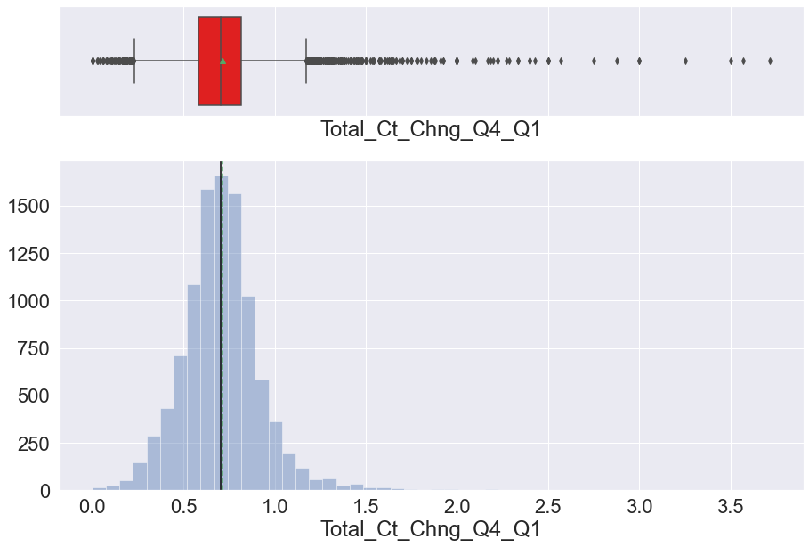
Total_Ct_Chng_Q4_Q1
Outliers exist on both the left and right sides. Outliers on the left need not be treated since they are close to the other values. After examining the visualization together with the table of values of Total_Ct_Chng_Q4_Q1, the right outliers were treated by capping them at 1.6. Overall, the ratio tends to be lower with attrited customers.

Slide 17
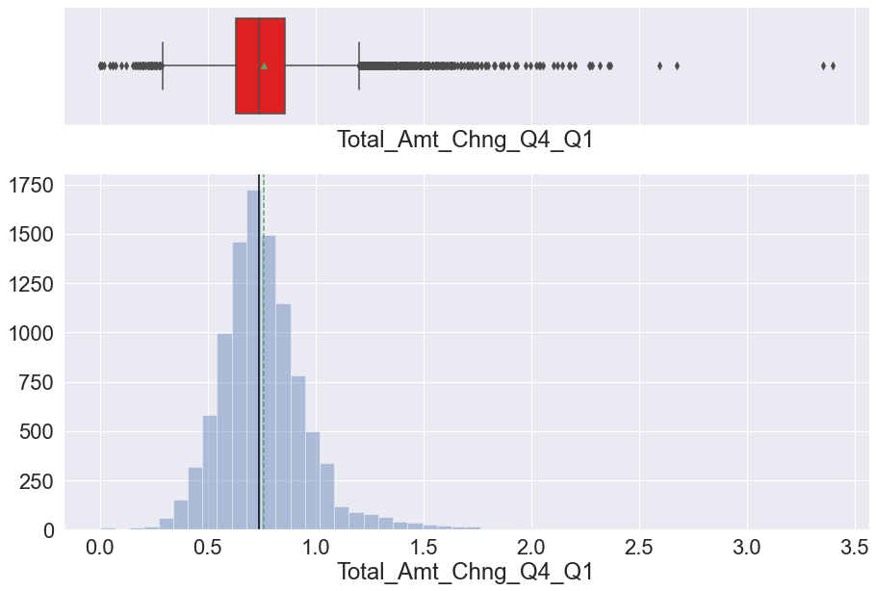
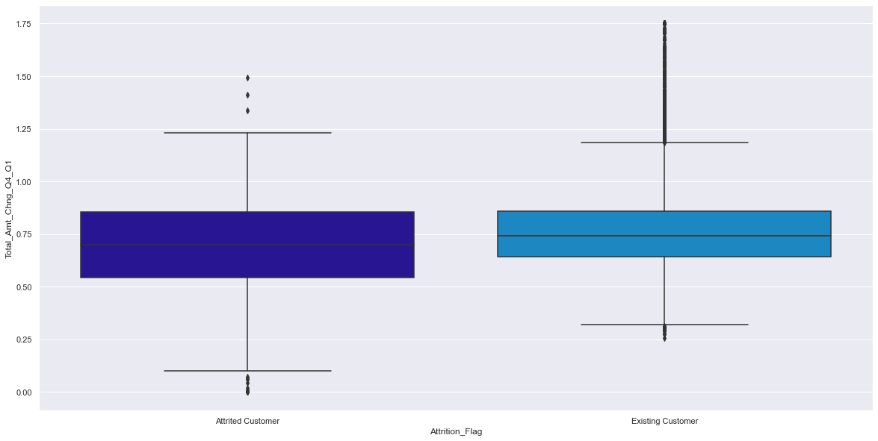
Total_Amt_Chng_Q4_Q1
Outliers exist on both the left and right. Outliers on the left need not be treated since they are close to the other values. After examining the visualization together with the table of values of Total_Amt_Chng_Q4_Q1, the right outliers will be treated by capping them at 1.75. The ratio has a wider range (range includes lower ratios) with attrited customers.

Slide 18
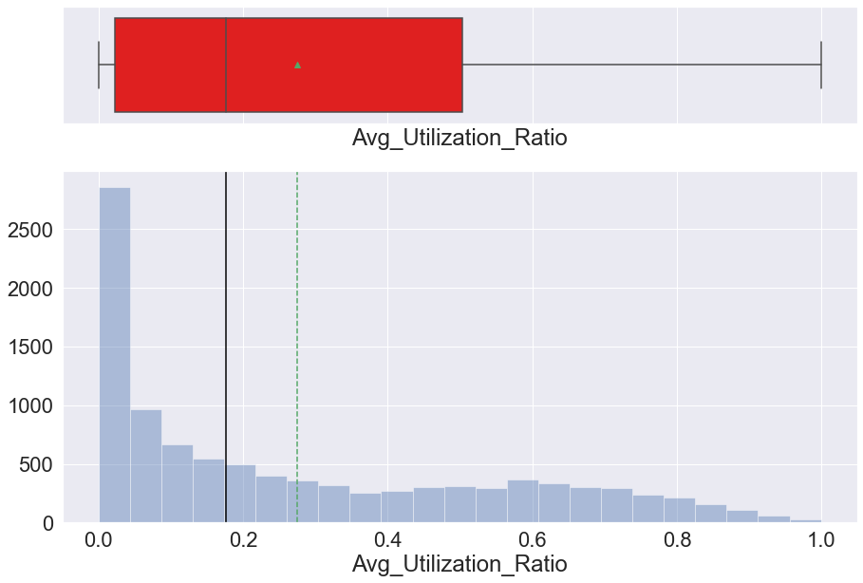
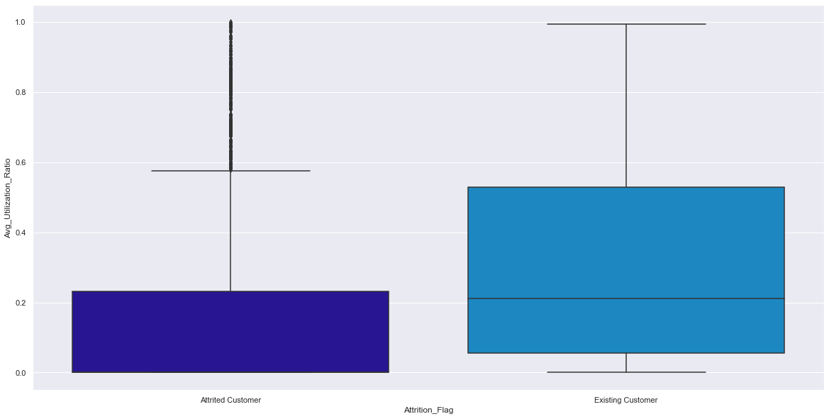
Avg_Utilization_Ratio
Approx. 2700 have an average utilization ratio of 0. Ratio range is wider (includes higher ratios) with existing customers.

Slide 19
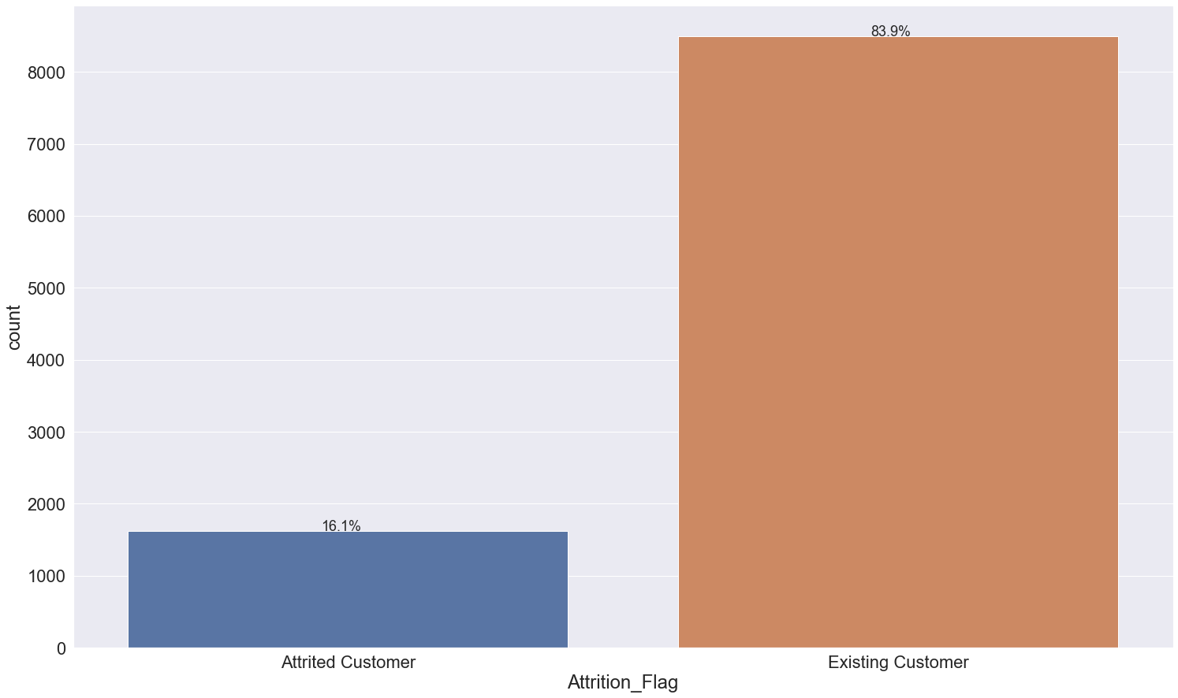
Attrition_Flag
By a large margin, most customers are current customers.

Slide 20
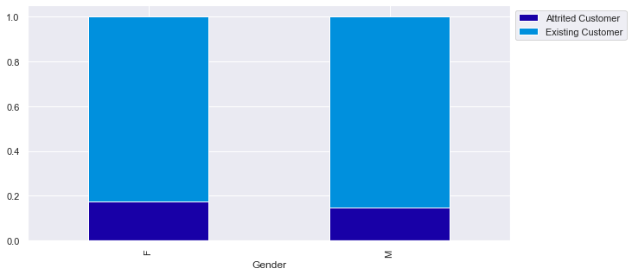
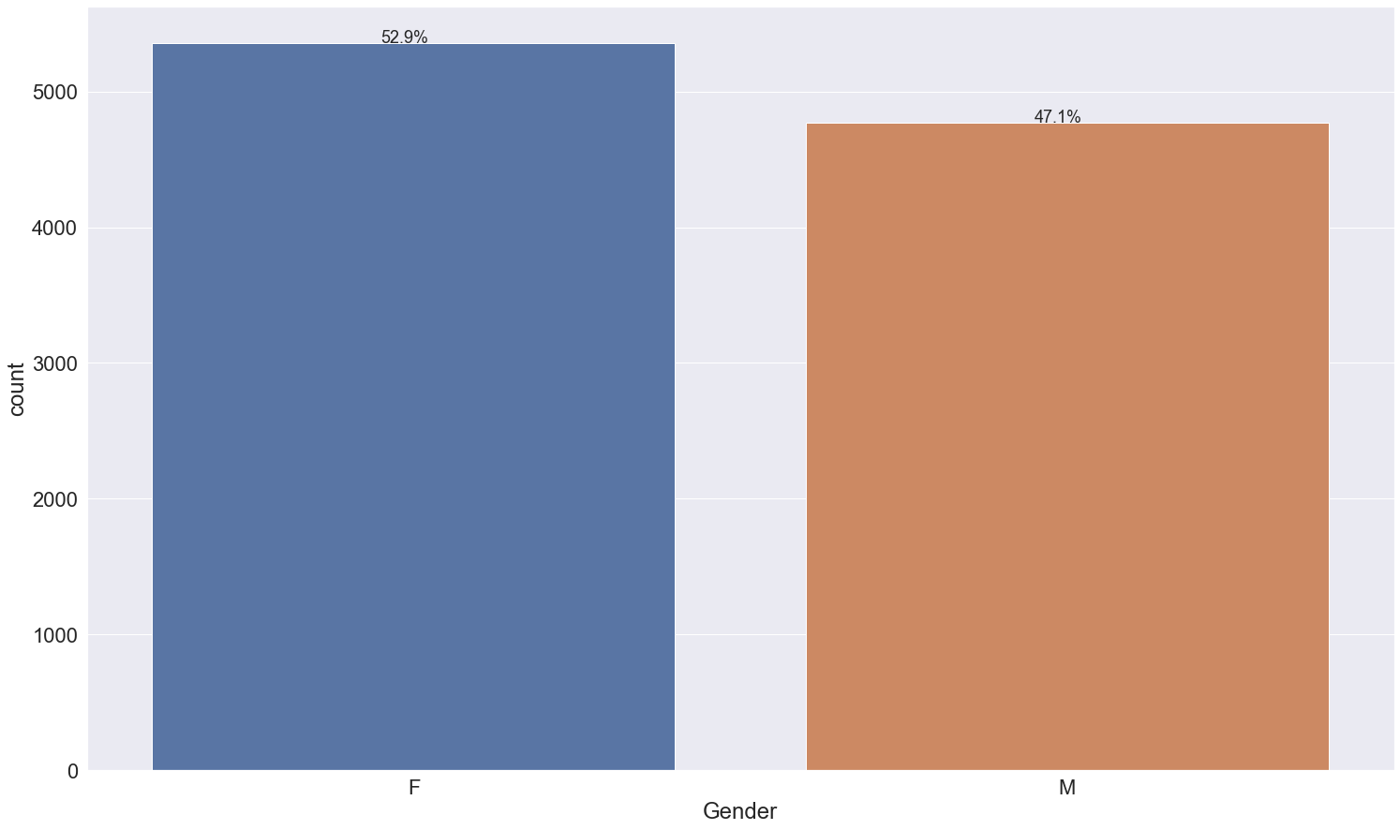
Gender
By a small margin, most customers are female.
Number of males and females does not seem to differ with attrited customers vs. existing customers.

Slide 21
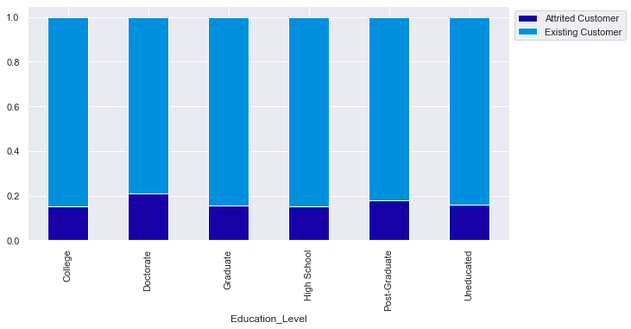
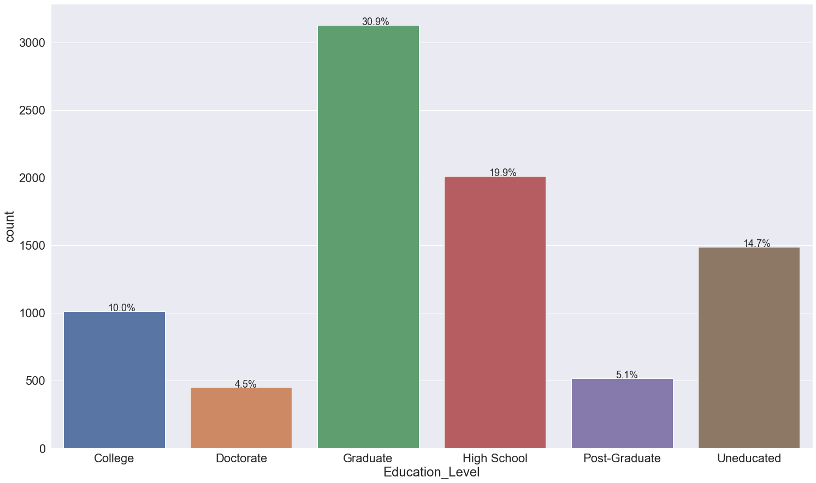
Education_Level
* Most customers have a graduate degree.
* More customers are uneducated than have a college degree.
* Only a small percentage have doctorate degrees or post-graduate education.
* Among the attrited customers, slightly more are doctoral and post-graduates.

Slide 22
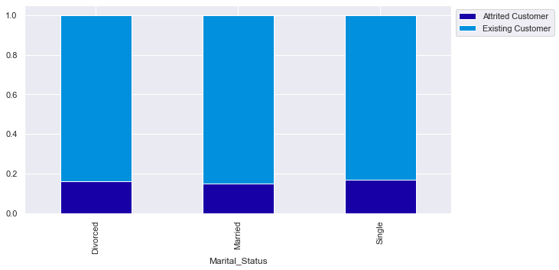
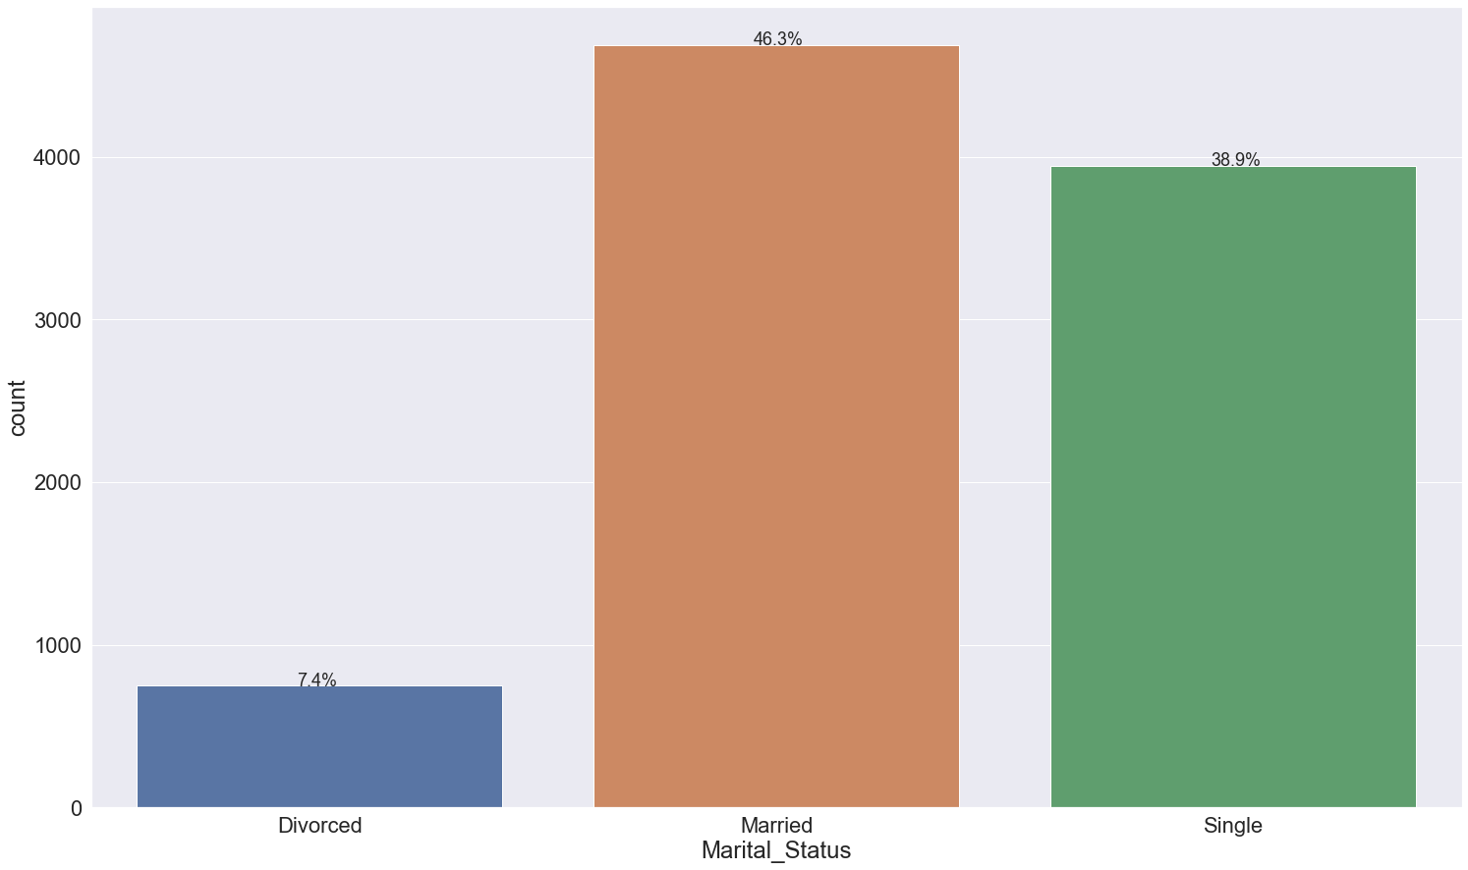
Marital_Status
* Most customers are married.
* Only a small percentage of customers are divorced.
* There seems to be no difference in the categories when it comes to being an attrited vs. an existing customer.

Slide 23
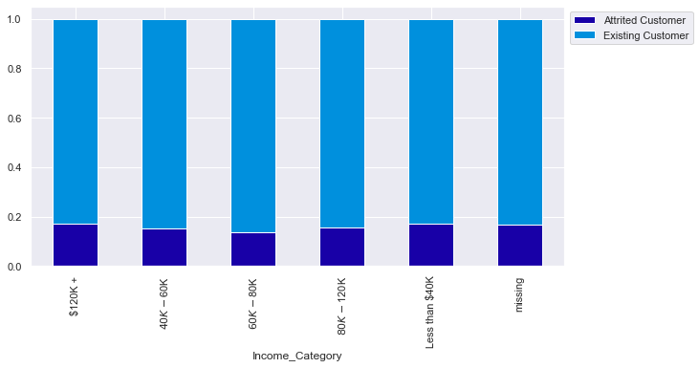
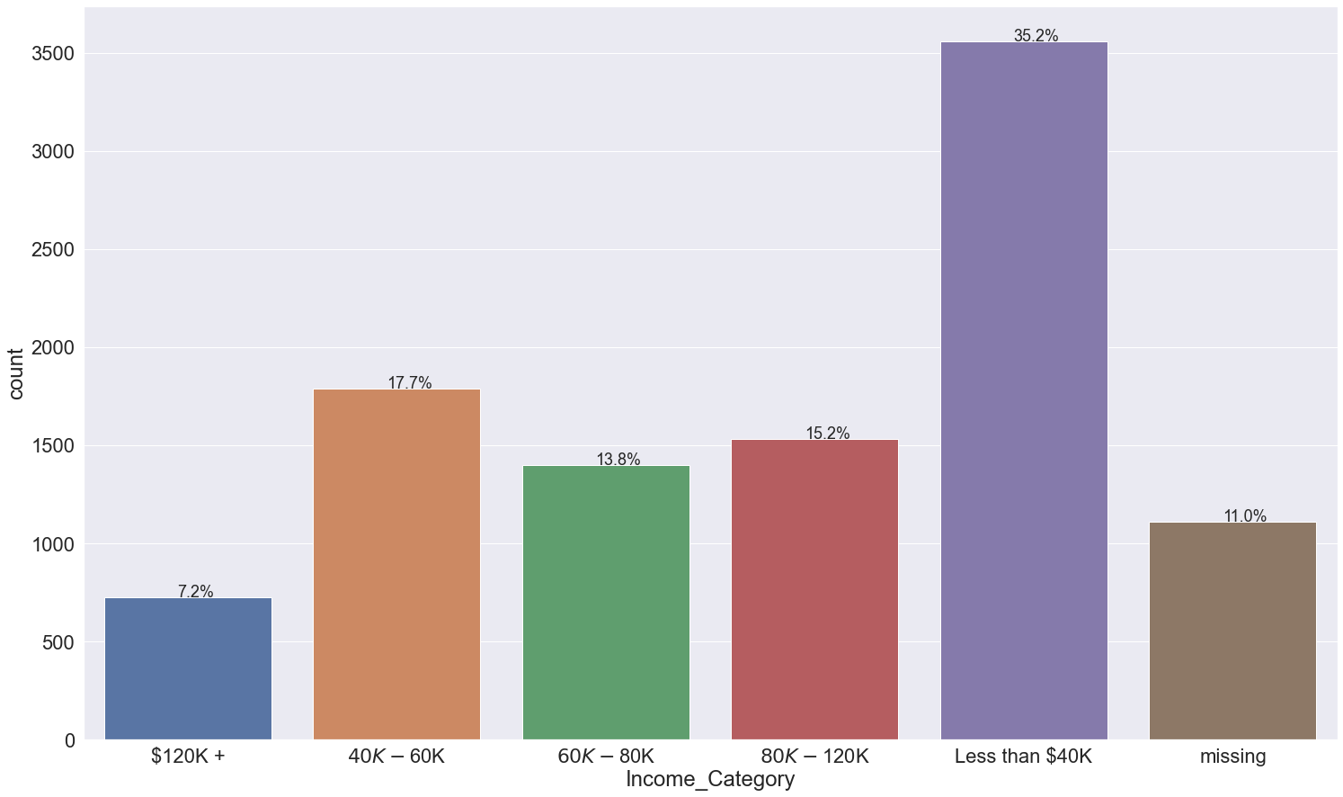
Income_Category
By a large margin, most customers earn less than $40,000.
Slightly less in the 60K-80K range tend to be attrited.

Slide 24
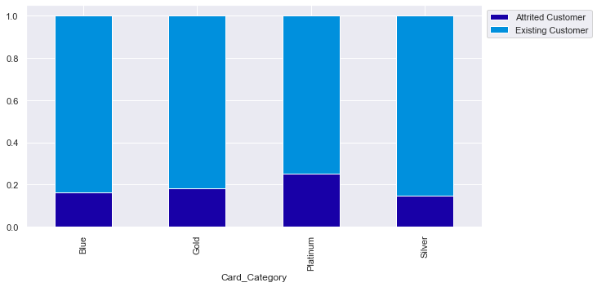
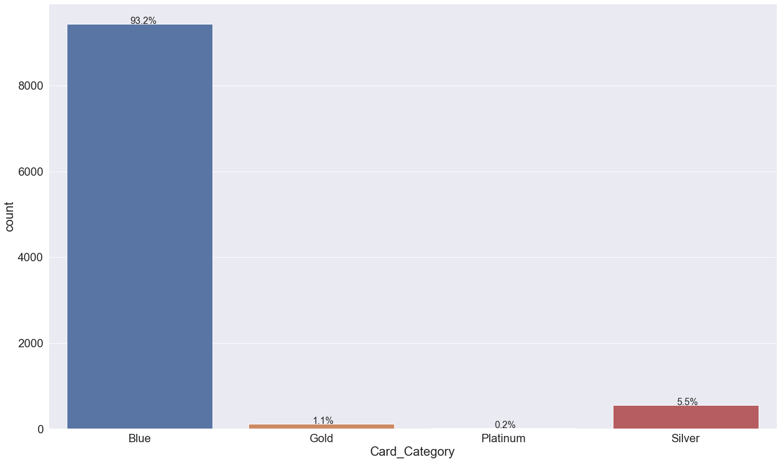
Card_Category
By a significant margin, most customers are in the Blue card category.
Slightly larger number of Platinum members tend to be attrited.

Slide 25
Model Summary

Slide 26
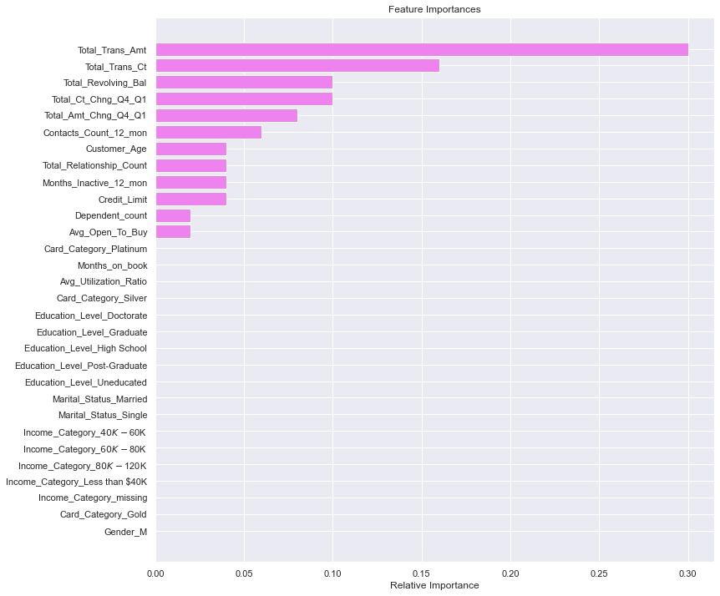
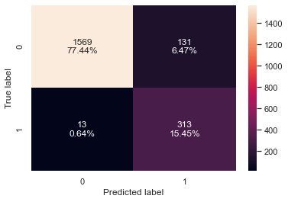
AdaBoost Model on Undersampled Data

Slide 27
Conclusion
Total Transaction Amount is the most important variable in terms of determining if a customer is attrited. This value tends to be higher for existing customers. Thera Bank in an effort to increase balances could offer programs for credit card holders where they earn points for dollars spent, incentivizing spending with the credit card. Similarly, they could create a balance transfer offer (0% or low percent interest rate on balance tranfers for an allotted period of time).
Total_Trans_Ct or Total Transaction Count is also an important variable in determining if a customer is attrited. This number tends to be higher with existing customers. Thera Bank could investigate offering deals at certain merchants if their card(s) are used (e.g., discount when using your Thera Bank credit or debit card) incentivizing the increase in transactions.
Most attrited customers make less than $40,000. Thera Bank could target this population by offering lower interest rates on cards with smaller credit limits, or cards with lower fee schedules.
Attrited customers tend to have had less products with the bank. Thera Bank could research offering new membership plans or accounts to people with only 1 card (e.g., no fees or lower interest rates if you have both a debit and credit card with the bank).

